Slide 1

EPS Week 3

Slide 2
Plan
Week 1 : Sơ đồ khối, các bộ phận chung (sơ đồ bố trí chung), Chức năng của các sensor , nguyên lý hoạt động chung
Week 2 : Rack and Pinion Steering (Steering Columns and Steering Linkage Mechanisms)
Week 3 : Introduction of Active Steering in BMW car, System Operation
Week 4 : Control Strategy and Models in AFS, Bus System Overview
Week 5 : Use case and solution in real life (advantages + disadvantages), new solution (being researched) ( 4-wheel steering, …)
Week 6: Back-up week.
Week 7 : Present about EPS system.

Slide 3
Principles of Operation

Slide 4
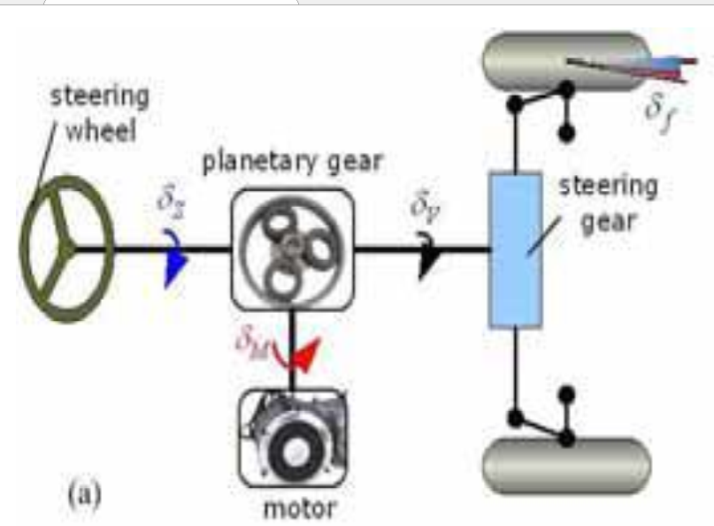
Notes:
Schematic view of AFS system An_Overview_of active steering system
Có 2 input và 1 output

Slide 5
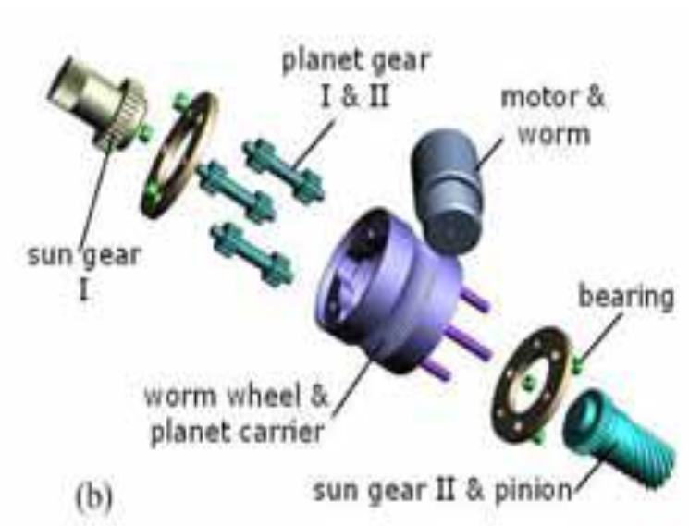
Notes:
3D-model of planetary gear set and electric motor An_Overview_of active steering system
Đây là 3d model bao gồm 1 bánh răng mặt trời đầu vào, 1cái đầu ra, 2 bánh răng hành tinh và motor cùng các bánh răng

Slide 6
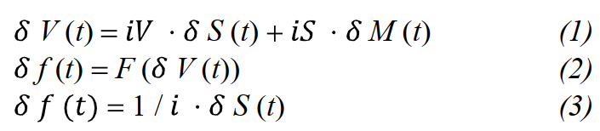
Relationship between those input

Slide 7
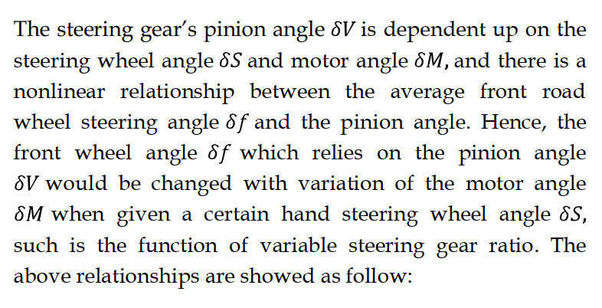
Notes:
Bỏ

Slide 8
Layout
AFS has :
A set of planetary gears which are used to change the drive ratio by applying an additional angle to steering box
Electronic servo steering system, which provides assist steering power for driver.

Slide 9
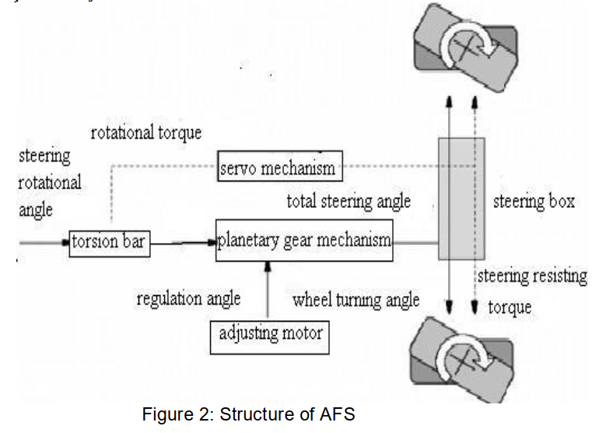
Notes:
Figure 2 shows the steering angle superposition principle. The significant difference with conventional steering system is that AFS can not only adjust steering torque, but also regulate the steering angle and make it match the current vehicle speed perfectly

Slide 10
Variable steering ratio
The variable steering gear ratio adapts the steering gear ratio to the road speed and the steering angle requested by the driver The driver no longer needs to grip the steering wheel excessively. When the vehicle is stationary, 2 turns are enough to move the steering wheel from one lock to the other.
At high speeds (> 75 mph), active steering allows a more indirect steering gear ratio than do conventional steering systems. The servomotor operates in the opposite direction to the steering-wheel angle at high speeds.
Unintentional steering movements are prevented in conjunction with the increased steering torque level (Servotronic).
Notes:
Tỷ số truyền lái biến thiên điều chỉnh tỷ số truyền lái phù hợp với tốc độ đường và góc lái theo yêu cầu của người lái. Người lái xe không còn cần phải bám vô lăng quá mức. Khi xe đứng yên, đủ 2 vòng để chuyển vô lăng từ khóa này sang khóa kia.
Ở tốc độ cao (> 75 dặm / giờ), hệ thống lái chủ động cho phép tỷ số truyền gián tiếp hơn hệ thống lái thông thường. Động cơ servo hoạt động theo hướng ngược lại với góc của bánh lái ở tốc độ cao.
Các chuyển động lái không chủ ý được ngăn chặn cùng với việc tăng mức mô-men xoắn lái (Servotronic).

Slide 11
Variable steering ratio
The actuator motor and planetary gear set in the rack and pinion unit make it possible to vary the steering ratio to according to road speed..
To achieve all of this, the actuator motor is driven in the same direction as the steering input. This “decreases” the ratio which has the effect of “over-driving” the steering input.
Notes:
During low-speed maneuvers, the steering ratio is more direct (i.e., 10:1). The direct ratio allows the driver to apply the least amount of driver input to achieve a larger amount of steering output
This effect can be compared to walking on an escalator. Walking in the same direction as the escalator will multiply overall input (walking). (so sánh thang cuốn)

Slide 12
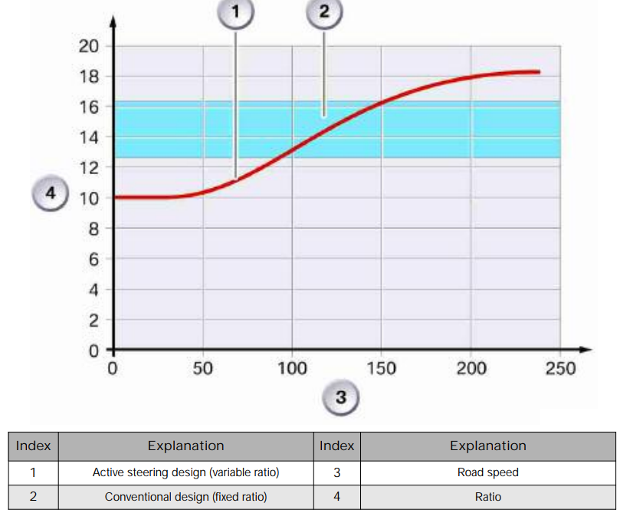
Variable steering ratio
Notes:
Bảng so sánh sự khác nhau giữa fixed ratio và variable ratio
Direct khi xe dừng
Indirect khi xe chạy nhanh
In this case, the actuator motor is driven in the opposite direction as the steering input. This increases the ratio which has the effect of “dampening” or “under-driving” of the steering input.
So sánh với việc đi ngược thang cuốn

Slide 13
Yaw-rate Control
AS systems can control oversteer and understeer situation due to Variable steering ratio as mentioned above.
For example, during a potential oversteer situation, the active steering system has the capability to “counter-steer” before the driver perceives any excessive vehicle yaw. This provides a stabilizing effect

Slide 14
Components

Slide 15
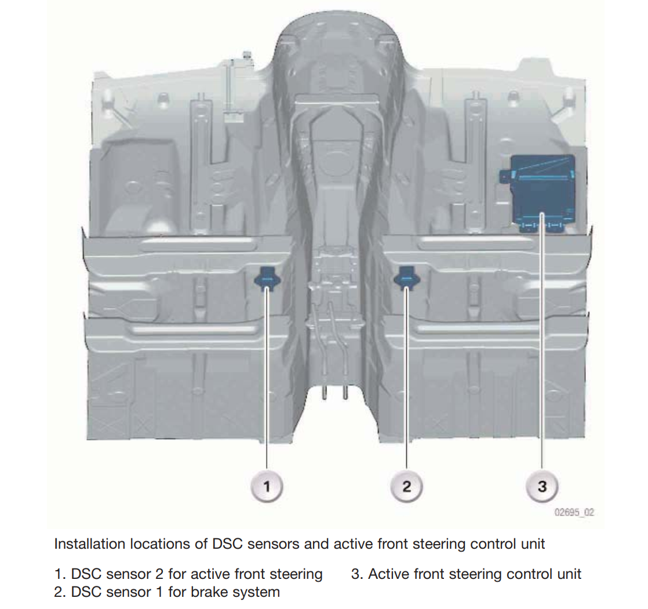
Notes:
The lateral-acceleration and yaw-rate sensors are combined in a single housing and designated the DSC sensor. The active front steering system is also provided with a second DSC sensor in addition to the DSC sensor fitted as standard. DSC sensor 1 is located under the right front seat. DSC sensor 2 is located under the left front seat. The two DSC sensors are technically identical but coded by means of the software so that they cannot be mixed up. DSC sensor 2 is used for redundant signal acquisition of yaw-rate and lateral acceleration. Both sensors supply yaw-rate and lateral acceleration signals. The use of two DSC sensors makes it possible to perform the plausibility check
Note: Để chống oversteering và understeering, mình dùng AS kết hợp với DSC, khi AS không phản ứng kịp thì DSC sẽ hoạt động

Slide 16
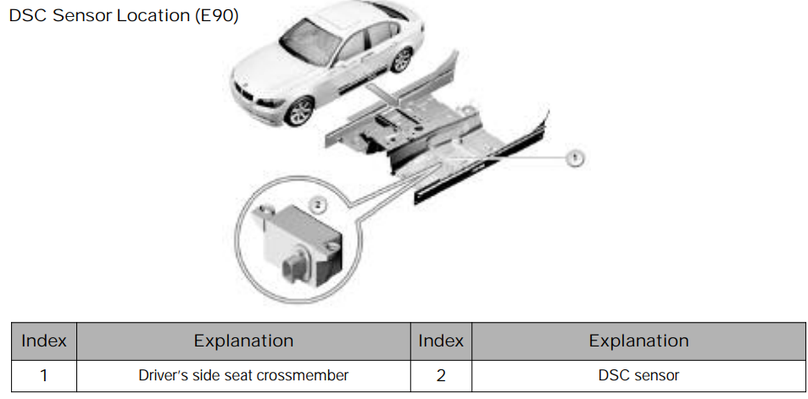
Notes:
The lateral acceleration sensor and yaw-rate sensors are combined in a single housing and designated the DSC sensor (sensor cluster). Both sensors are connected to the F-CAN. The sensor is located under the driver’s seat.
The DSC sensors are a combination of lateral acceleration and rate-of-yaw sensors. The DSC sensor consists of:
• Housing with connector
• Damper to prevent mechanical over-stressing
• Sensor element : The sensor element consists of 2 piezoelectric acceleration sensors. A spring-mounted weight is hung in the measuring cell of the acceleration sensor

Slide 17
Active Front Steering Control Unit
The active front steering control unit is in the right footwell and
screwed down to the floorpan.
The control unit is protected by a kickplate housing.
The kickplate housing incorporates a pin for connecting the shielding for the 3 phases of the active front steering actuating unit.
The control unit is integrated in the vehicle electrical system via the PTCAN and the F-CAN
The active front steering control unit calculates the signals for activating the active front steering actuating unit from the various input signals.

Slide 18
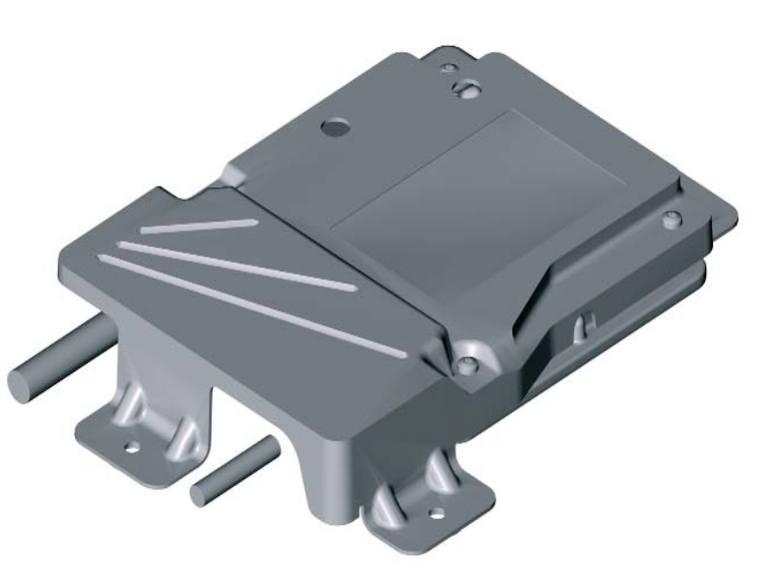
Notes:
Input Signals
• DSC signals (wheel speeds, yaw rate and lateral acceleration) • Steering angle • Total (summation) steering angle • Position of electric servomotor of actuating unit The active front steering control unit is initialized when the ignition is turned on. The active front steering actuating unit cannot be activated during the initialization procedure. The sensor signals are checked and calibrated if necessary. If faults are detected, either the "Error" fault status is adopted, or yaw rate control is deactivated. In the case of the "Error" fault status, it is not possible to activate the actuating unit. The "Drive" status is adopted after successful initialization. The active front steering control unit sends the current message corresponding to the required flow rate to the SGM via the PT-CAN.

Slide 19
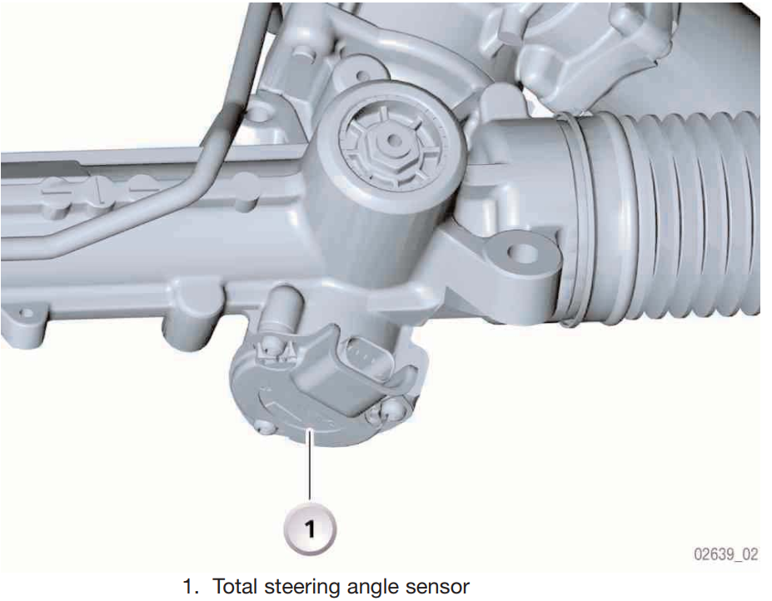
Notes:
_ Total Steering-Angle Sensor
The total (summation) steering-angle sensor is only fitted in the vehicle if the active front steering system is fitted. The total steering-angle sensor records the rotation angle of the steering pinion and thus the wheel deflection (or actual steering angle) of the vehicle. The total steering-angle sensor is flange-mounted at the bottom of the steering gear.

Slide 20
Steering-Angle Sensor
The steering-angle message is directed from the steering column switch cluster (SZL) to the active front steering control unit via a serial interface and via the F-CAN.
The SZL incorporates a second processor for redundant steering-angle calculation. This second processor is only fitted if the active front steering system is fitted and serves to monitor the plausibility of the signal.
The steering-angle sensor is integrated in the steering column switch cluster

Slide 21
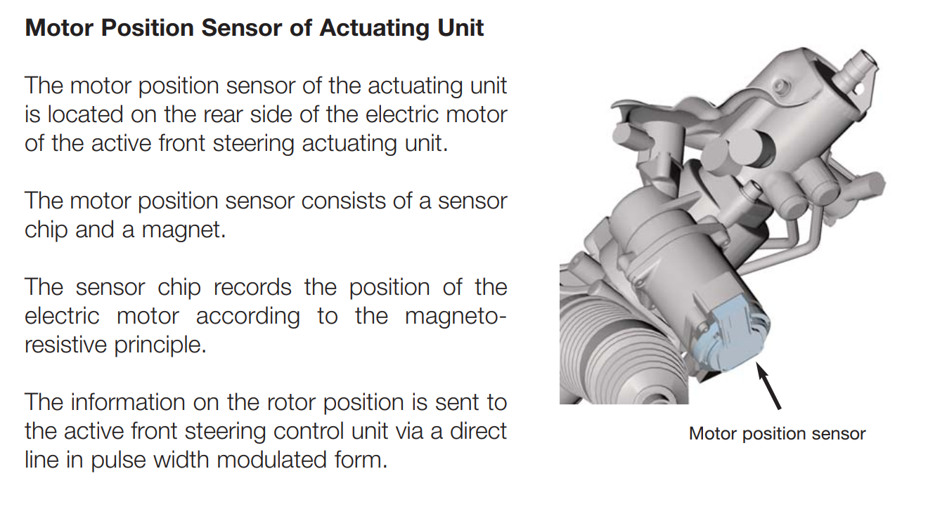
Notes:
06_E60_Active Front Steering

Slide 22
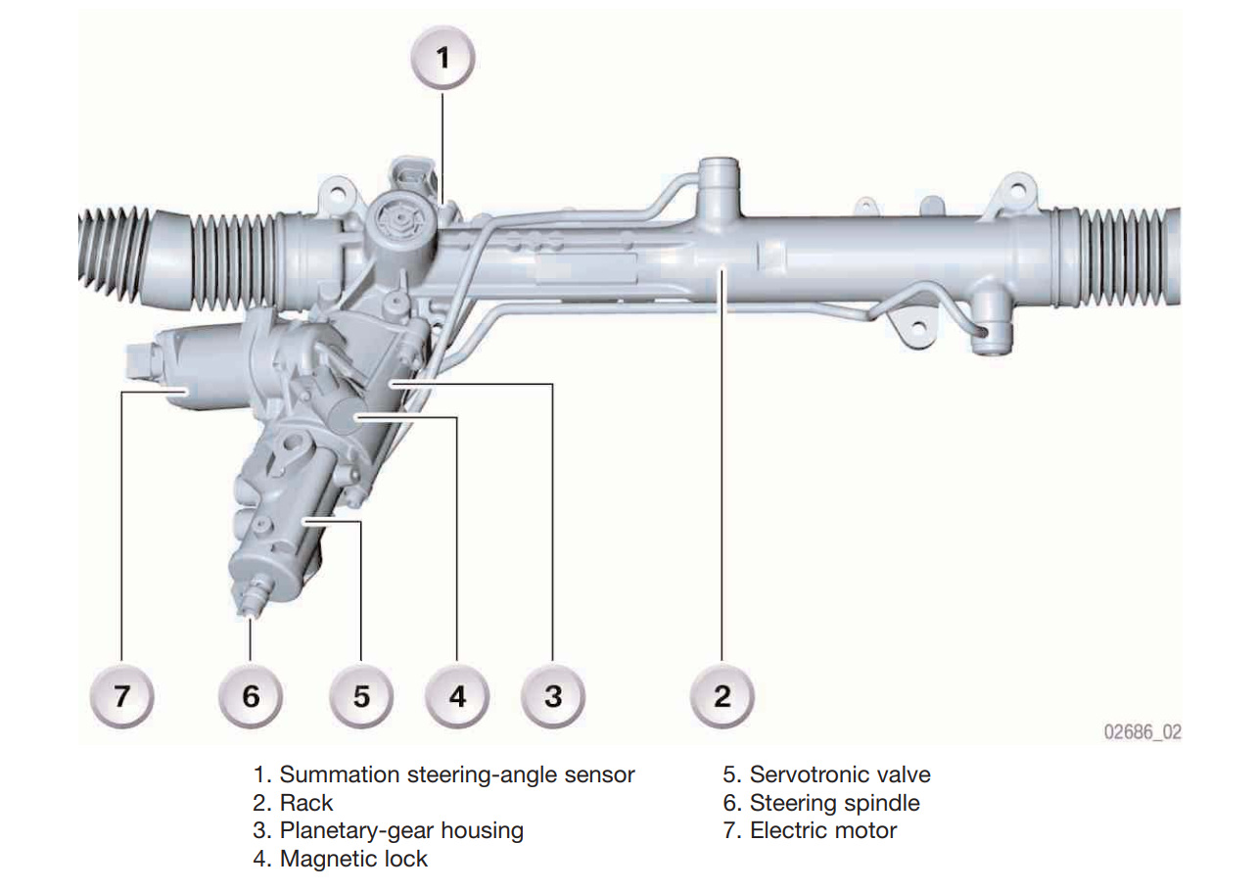
Notes:
_ Active Front Steering Actuating Unit
The active front steering actuating unit is located on the steering gear. It is integrated in the split steering column between the Servotronic valve and the rack. This actuating unit comprises a brushless synchronous DC motor and a planetary gear. The core component of the active front steering actuating unit is a planetary gear with 2 inputs. One input is from the driver via the steering spindle, the other is from the ring gear via the actuator motor

Slide 23
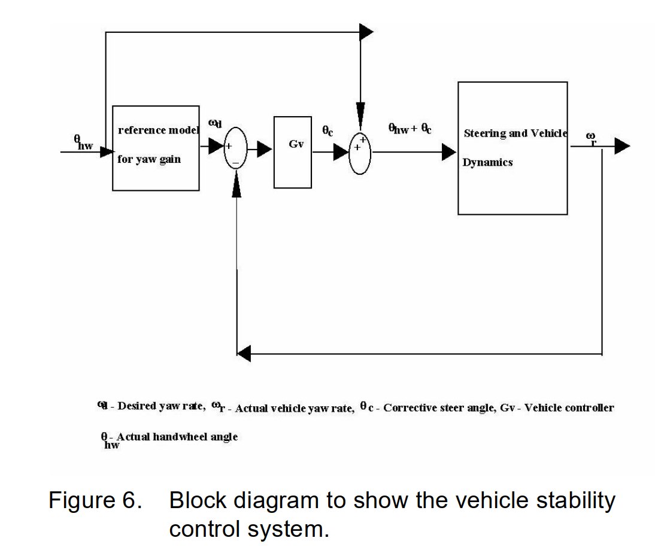

Slide 24
System Operation
Unlike DSC, which can be switched off by means of the DTC button, Active Steering cannot be completely deactivated.
The functions of Yaw-rate control and yaw-moment compensation are deactivated when DSC is switched off. However, the variable steering-gear ratio always remains active.
When DTC is active, the response thresholds for DSC are widened. Active Steering increasingly assumes the function of driving stabilization if the vehicle is oversteered.

Slide 25
Reference
Design of Front Wheel Steering
Active Front Steering
An Overview of Active Steering
Concept and Functionality of the Active Front Steering System

